Slide 1
Final Project: Predicting Happiness
Lauren Gardner, Danica Tiegs, Stacy Wai, Siara Leininger and Courtney Muhlbach

Slide 2
Main Question
Can certain factors be used to predict a country's happiness score?

Slide 3
Data Sources Used
Throw csvs from readme

Slide 4
Methods Explored
Supervised
Multiple Linear Regression
Unsupervised
Clustering
1. Kmeans
a. Silhouette score
b. Elbow method
c. parallel coordinates

Slide 5
Correlation Matrix

Slide 6
Clustering

Slide 7
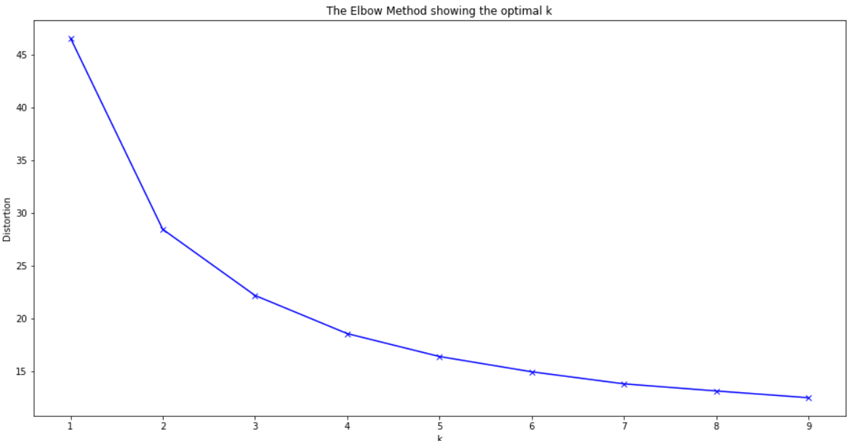
Elbow Method
Concave part of the elbow determines the clusters needed

Slide 8
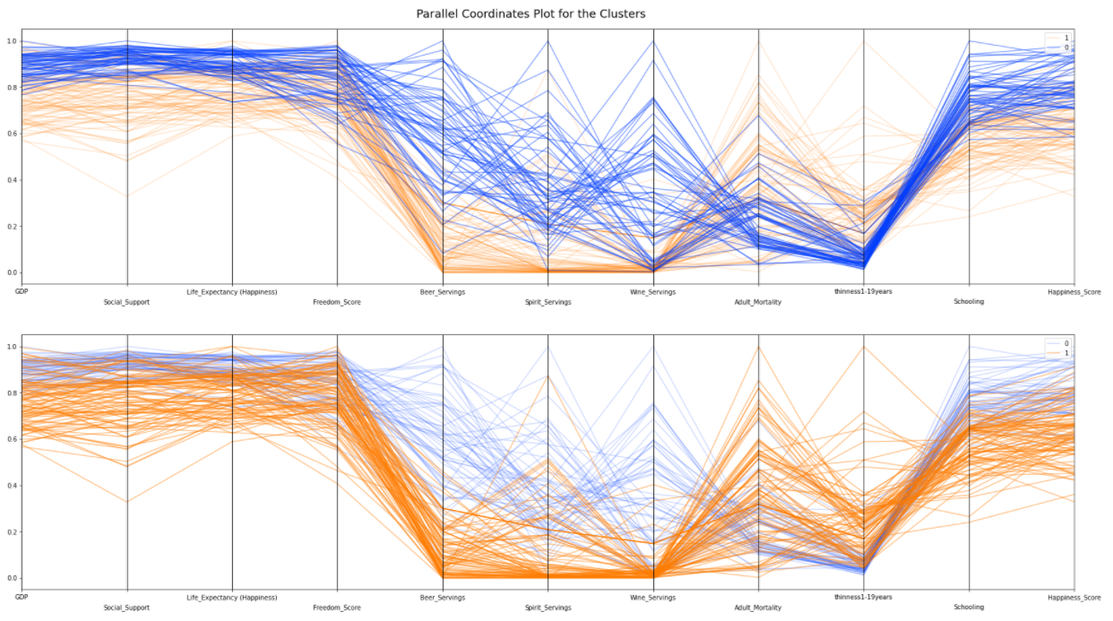
Parallel Coordinates
Maps the centroid of each cluster

Slide 9
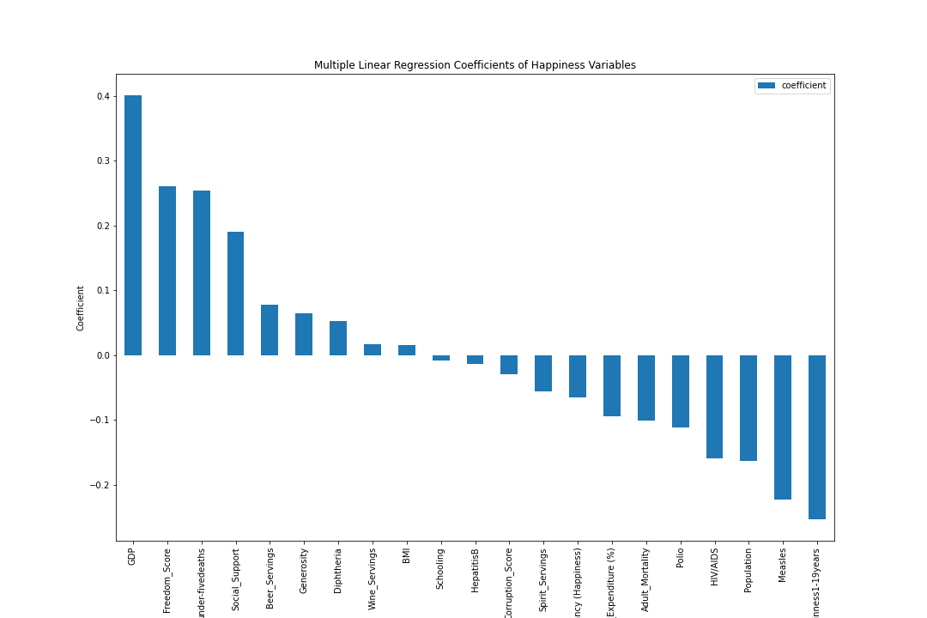
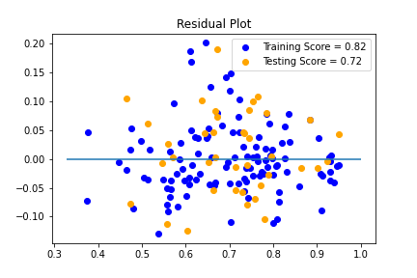
Multiple Linear Regression
Notes:
Positive - GDP, Freedom, <5 Deaths, Social Support
Negative - Thinness 1-19 years, Measles, Population, HIV/AIDs, Polio, Adult Mortality

Slide 10
Conclusions

